Slide 1
Automatic Audio Labeling for Daily Life Event Detection
Xuzhang Zheng, s4414268
Naixin Wang, s4657128
Aparajita Saha, s4009762

Slide 2
Problem Description
- Household/Daily life audio contains meaningful sound events (e.g. doorbell, door opening/closing, dog barking, etc.)
- automatically detect events (event type + timestamp) and create index of them
- these events are rarely annotated, difficult to search or analyze recordings.

Slide 3
Challenges
🎤 Noise & Overlap: daily recordings often contain noise and overlapping sound
🕒
Diversity: daily life events vary widely in duration and acoustic characteristics
🔀 Limited Data: labeled datasets for household/daily life sounds might be small

Slide 4
Goal For The Final Project
- Develop an API:
Input: Household/Daily life recording file
Output: A timeline of events with labels & timestamps
User can search ‘doorbell’ or ‘dog bark’ and jump directly to those segments
- Technical pipeline:
1. Preprocessing (denoising, normalization, segmentation)
2. Feature extraction (MFCC, spectrogram, embeddings)
3. Event classification using pretrained models (e.g., CNN, YAMNet, VGGish)
4. Event indexing and storage (timestamp + label)
5. Simple query interface (search by event type or timestamp)

Slide 5
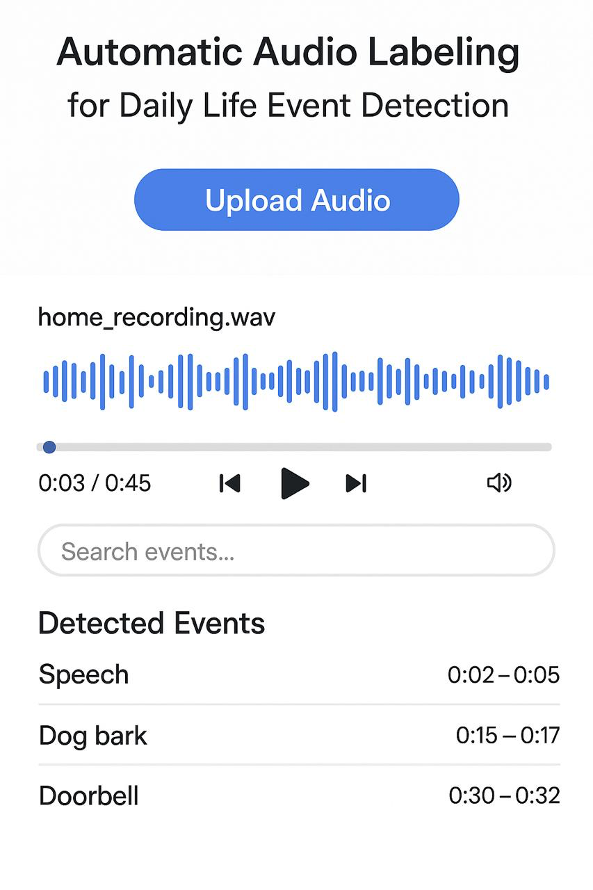
Expected Deliverable

Slide 6
Questions?

